Slide 1
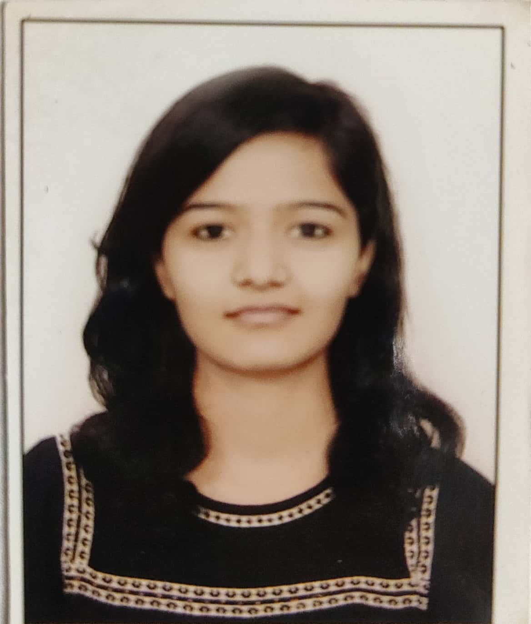

Varsharani Nagare
Analyst/Software Engineer
Bachelor of Engineering
Civil : 2017-2020
Skills C#
ADO. NET
ASP. NET Framework
ASP. NET Core MVC
Bootstrap
Database
SQL database – MySQL
Web Technologies
HTML5
CSS3
Add-ons
GitHub
Postman
Swagger
Tools
Visual Studio 2019
Additional Details
Leadership
Team management
Excellent Communication Skills
Mumbai
varsharani.nagare@capgemini.com
+91 9156314379
A4
Software Engineer who is Strong in design and integration with intuitive problem-solving skills. Passionate about implementing and launching new projects.
Ready to learn new technologies and implement them to further improve my knowledge.
Ability to learn, adapt and grow.
tend to keep an open-mind while maintaining stance or opinions.
Online Shopping Website
Developed a online shopping website along with JWT authentication, Swagger and Core API using Asp. Net Core MVC, Microsoft SQL and Bootstrap used for user interface.
AZ – 900 Microsoft Azure Fundamentals Certification
AZ- 900 Microsoft Azure Fundamentals.
Agile Software Development
Check out my work on GitHub

